Slide 1

Edison Development using Python
hello@hybus.net

Slide 2
Python
Interpretive language
System Utility, GUI, Web Programming, DB Programming
https://www.python.org/
print(“Hello world”)
using Python for accessing Intel Edison I/O from Linux
root@Hello:/# python
Python 2.7.3 (default, Mar 31 2015, 14:39:49)
[GCC 4.8.2] on linux2
Type "help", "copyright", "credits" or "license" for more information.
>>> import mraa
>>> mraa.getVersion()
'v0.x.x'
>>>
terminal
source : http://iotdk.intel.com/docs/master/mraa/python/mraa.html

Slide 3
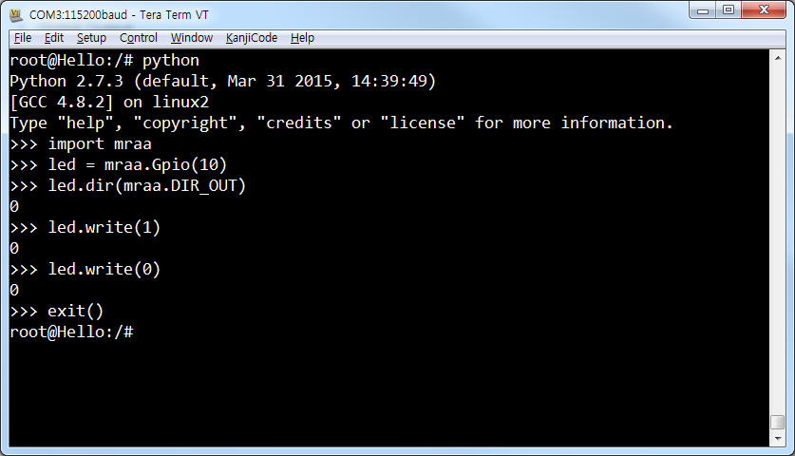
Digital I/O
디지털 입출력 핀을 사용하려면 Gpio 클래스 오브젝트를 만든 다음 입력으로 사용할지, 출력으로 사용할지를 dir() 메소드로 지정
We can verifiy GPIO on processor using the following command
root@Hello:~# cat /sys/kernel/debug/gpio
terminal
Digital Output
>>> led = mraa.Gpio(10) # Gpio object 생성
>>> led.dir(mraa.DIR_OUT) # 출력으로 설정
Digital Input
>>> sw = mraa.Gpio(4) # Gpio object 생성
>>> sw.dir(mraa.DIR_IN) # 입력으로 설정
Data Write
>>> led.write(1)
>>> led.write(0)
Data Read
>>> sw.read()

Slide 4
Blink
root@Hello:~# vi blink.py
terminal
import mraa
import time
led = mraa.Gpio(13)
led.dir(mraa.DIR_OUT)
while 1:
led.write(1)
time.sleep(0.5)
led.write(0)
time.sleep(0.5)
Example code
root@Hello:~# python blink.py
terminal
source : http://cafe.naver.com/thingdue

Slide 5
Analog Output(PWM)
root@Hello:~# vi ledpwm.py
terminal
import mraa
import time
x = mraa.Pwm(9)
x.period_us(700)
x.enable(True)
value= 0.0
while True:
x.write(value)
time.sleep(0.05) //duty ratio
value = value + 0.01
if value >= 1:
value = 0.0
Example code
root@Hello:~# python ledpwm.py
terminal
source : http://cafe.naver.com/thingdue

